Slide 1



Child Health Care System
By: Niramay Kelkar
Mourya Pratap Reddy Dassarapali
Deeksha Khajuria

Slide 2

Child Health Care System
Introduction- Problem Statement
How it has solved the issue?
Application-
Eco-System Architecture Diagram
UML Diagram
Workflow
Roles
Future Scope
Screenshots

Slide 3
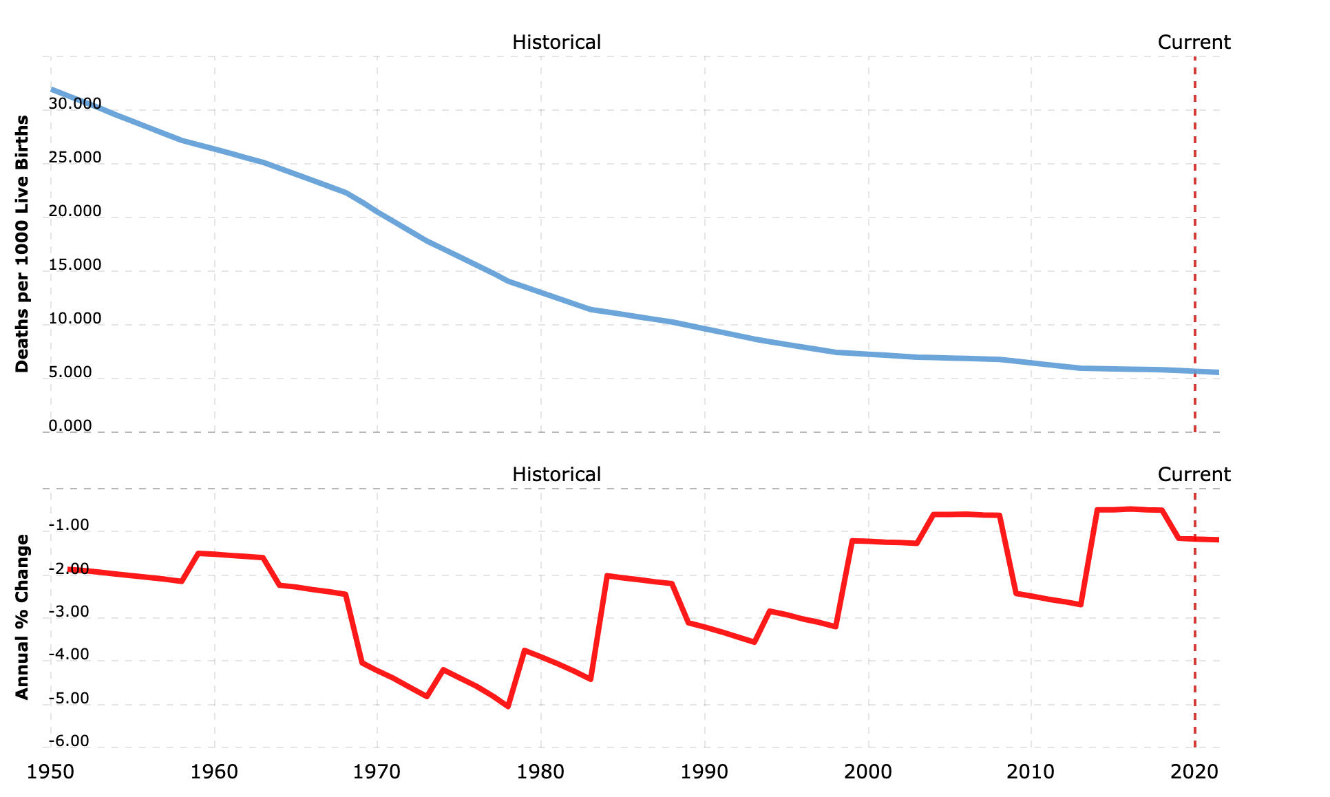
Few parents in these times do not have decent awareness to attend to one’s child’s health owing to both the parents’ jobs, or inattentiveness. The current infant mortality rate for U.S. in 2020 is 5.681 deaths per 1000 live births, a 1.17% decline from 2019. The infant mortality rate for U.S. in 2019 was 5.748 deaths per 1000 live births, a 1.15% decline from 2018.
Introduction
Src:macrotrends.net

Slide 4

Problems Addressed
The inability of some parents to provide optimum nutrition, vaccinations, and other health care because of reasons like financial instability, not decent awareness is the cause of our concern
The child needs a organ Donor or blood Donor in order to survive in case of emergency
In areas where there is no proper operating organization, people tend to get confused about reporting and worry about better medication and care for their children.

Slide 5

How it has solved the issue?
Application connects patient, doctors and donors
Non-Profit enterprise provides Donors who are interested in helping the underprivileged families financially, by donating organ or by donating blood.
Doctor can monitor the child’ data through the application and suggest medication
Applicant can hire licenced babysitters
Src:Googleimages

Slide 6
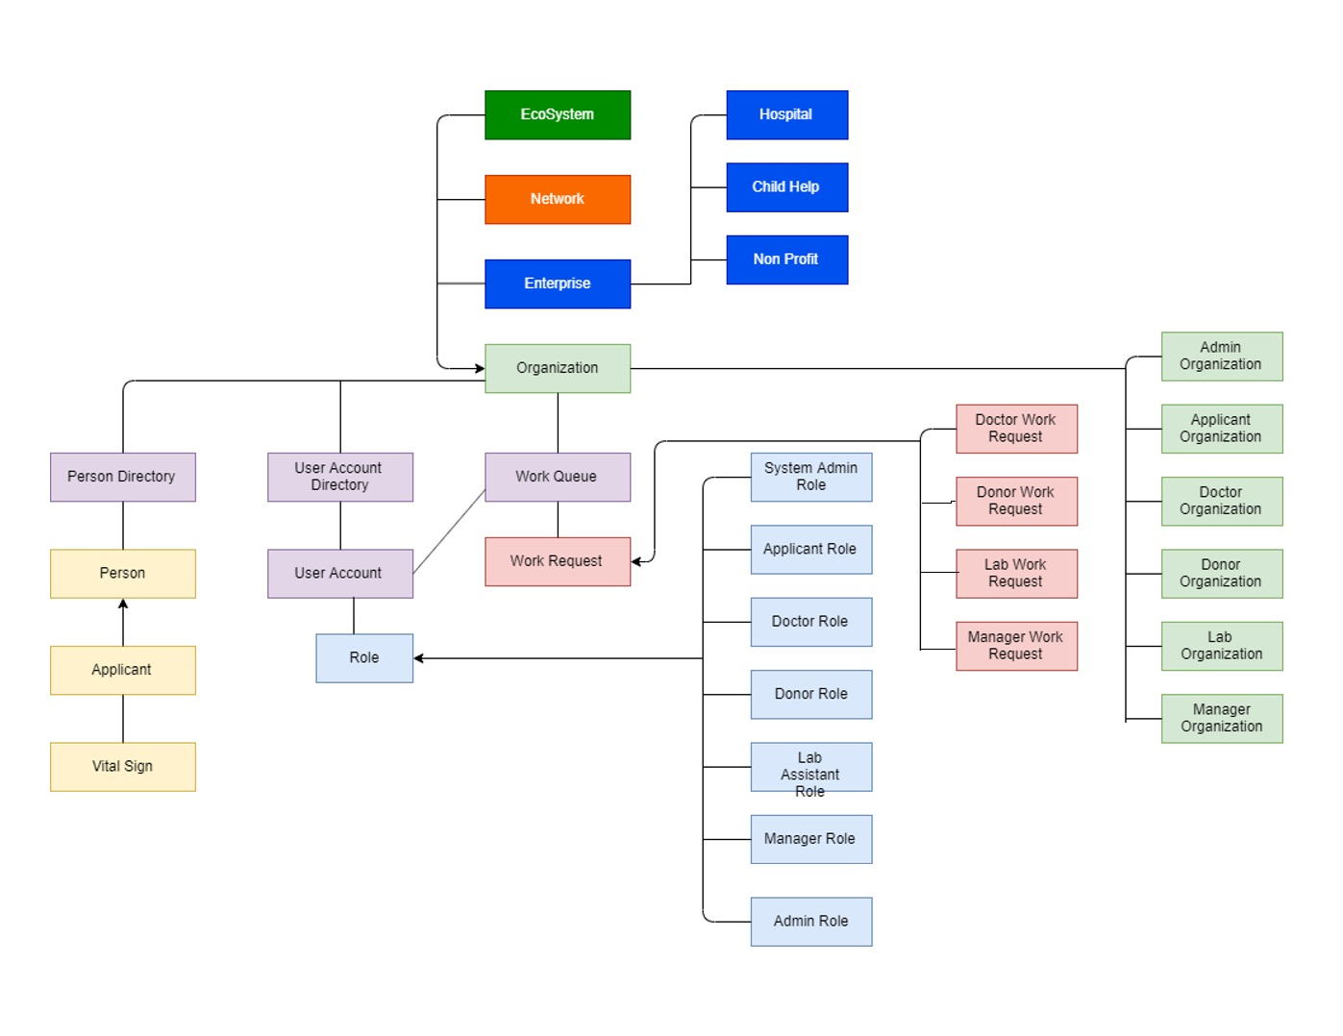
Eco-System Architecture

Slide 7
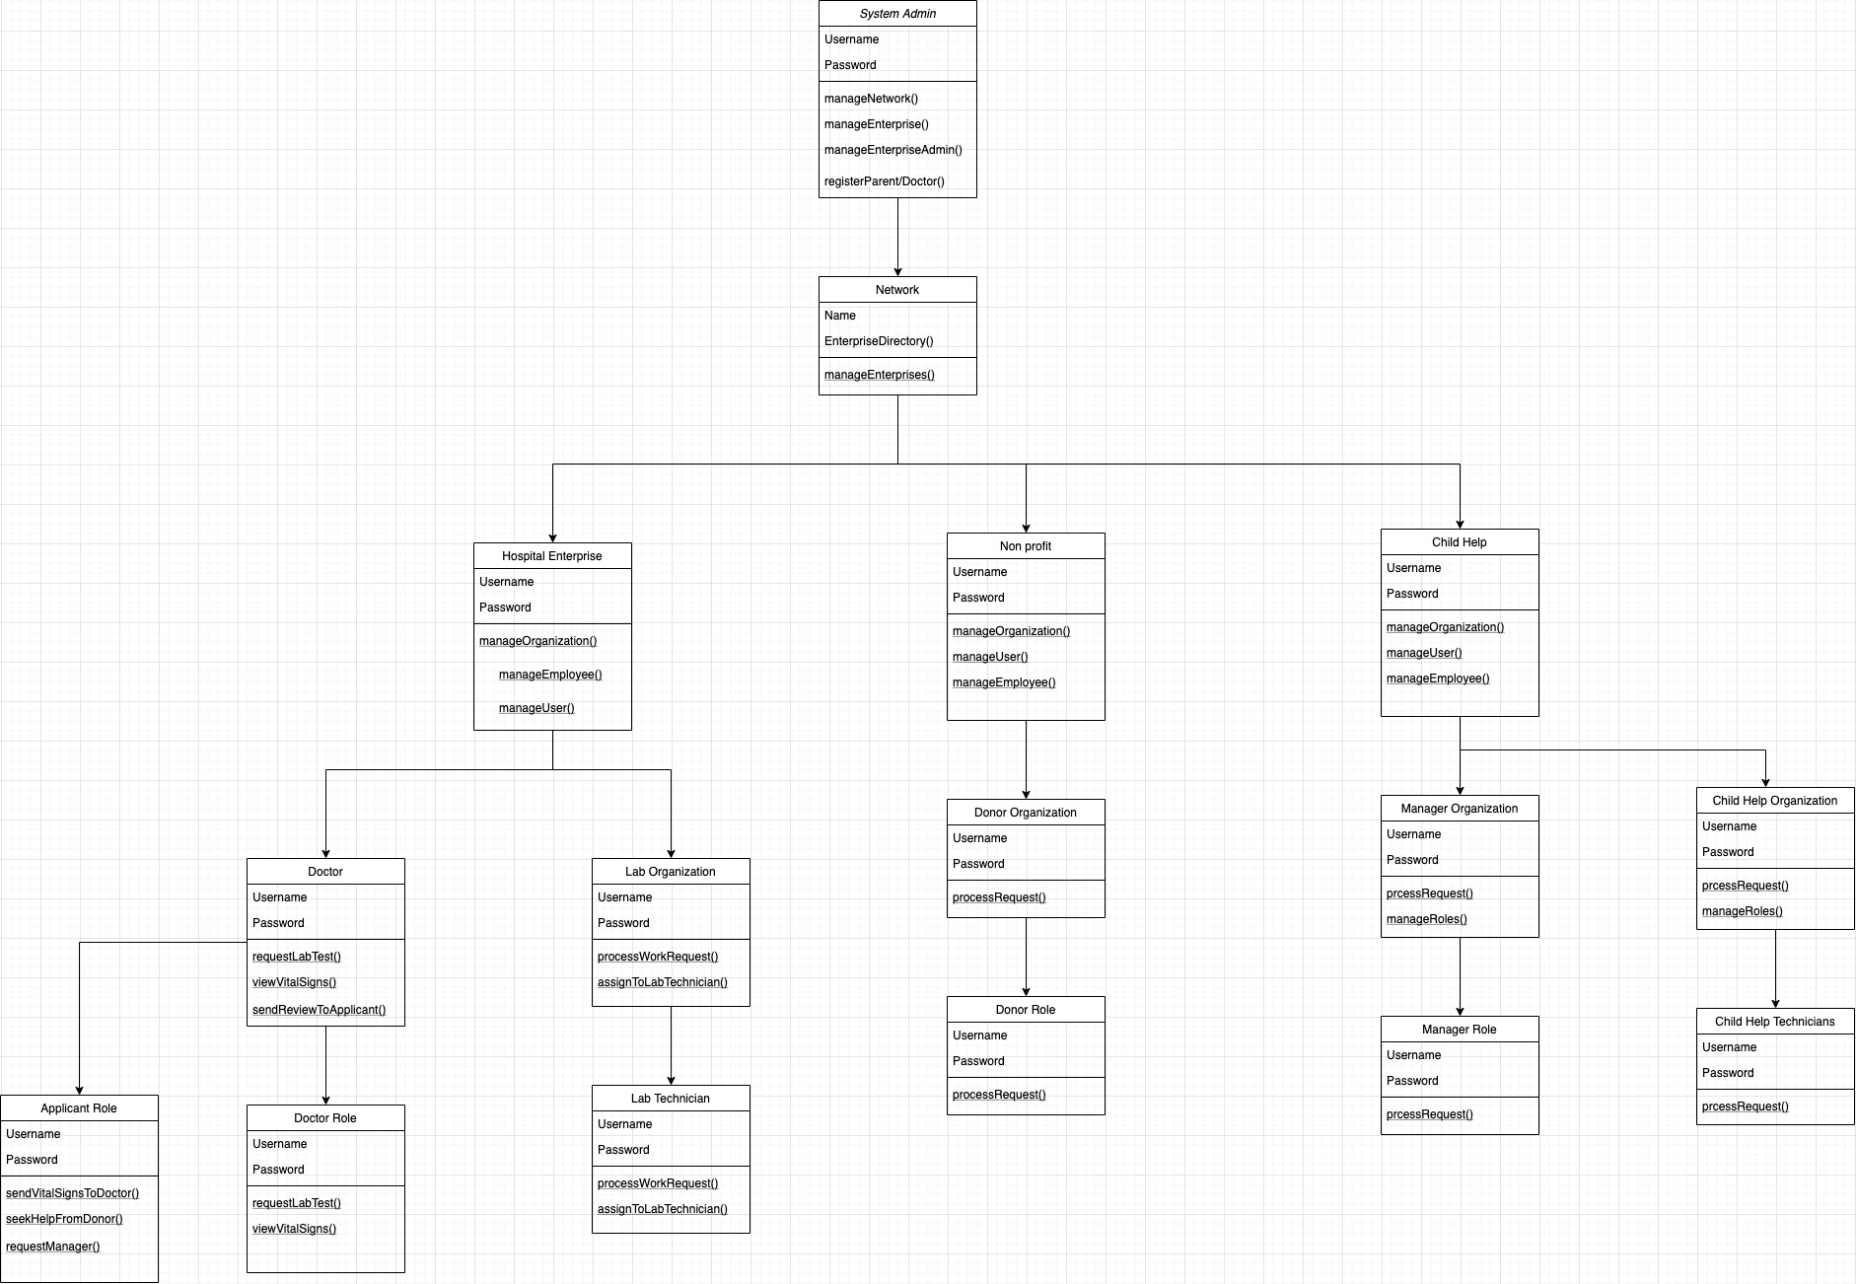
UML Diagram

Slide 8
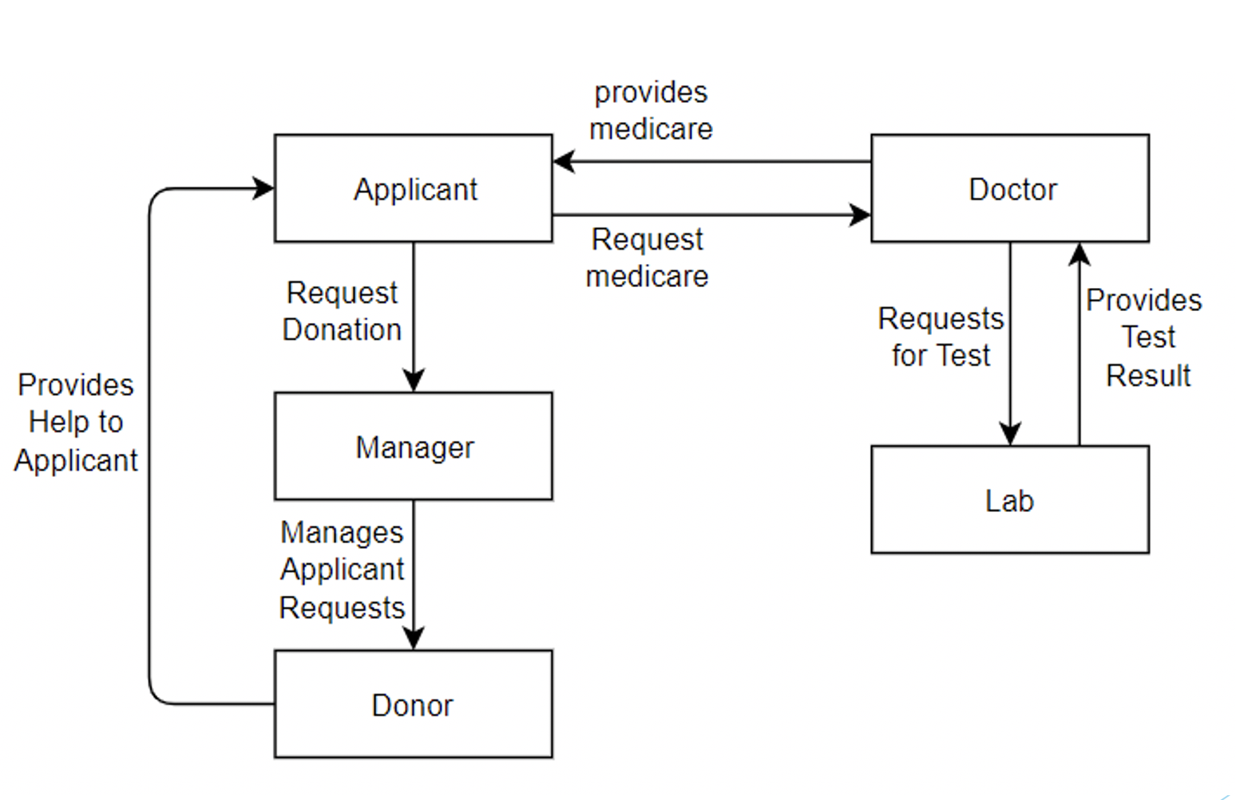
Workflow

Slide 9
Work Request Flow
The Applicant provides the vital sign data to the Doctor
Doctor analyses the vital sign data and requests Lab to perform tests if the vital sign data are abnormal
Lab Assistant performs the tests and sends the report back to Doctor
Doctor provides proper medication based on the report sent by the Lab
Applicant may apply for financial help or organ donation request from non profit organization’s donors according to the situation
Donors accepts the request from applicant and sends details to the manager for verification to proceed
Applicants receives the help upon approval of Manager

Slide 10

Roles
Applicant Role: The Applicant role raises various requests like request to Financial Help, request for organ donor or request for blood donor
Doctor Role: The Doctor receives the Vital Sign data sent by applicant for analysis, upon analysis, requests the Lab for lab test of those with abnormal Vital Sign data.
Donor Role: The Donor is to make donations as per the Applicant’s request or donating money to applicant via approval of Manager
Lab Assistant Role: Lab Assistant completes the test requests from the Doctor and sends back the report to the Doctor
Manager Role: The responsibility of the Manager is to enforce the system is working fine by identifying the need of recipient and making sure the help is reached to the eligible applicants.

Slide 11
Future Scope
Integrating Pharmacy Enterprise which co-ordinates with Hospital Organization and would be used to provide medicines and equipment prescribed by Doctor
Integrating Insurance Organization which provides cost-effective Insurances to help support Parents

Slide 12
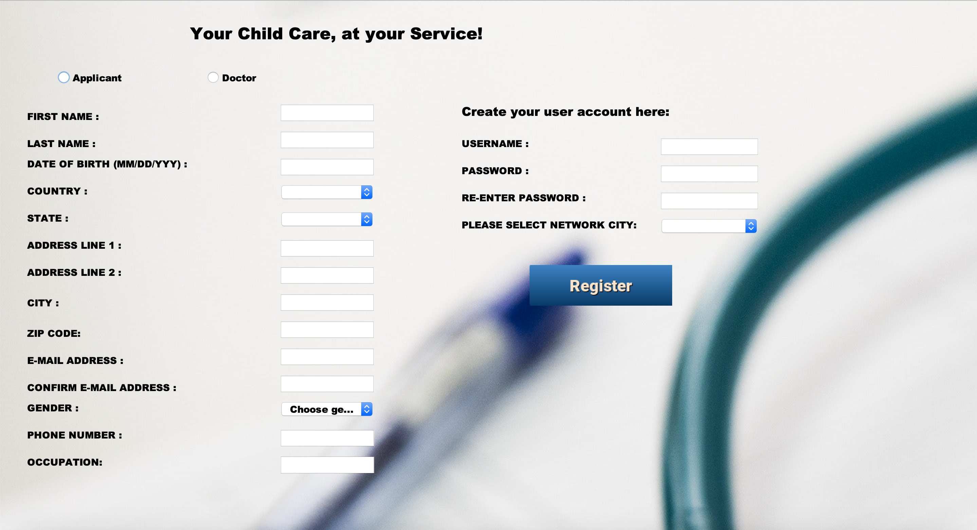
Registration Form for Applicants

Slide 13
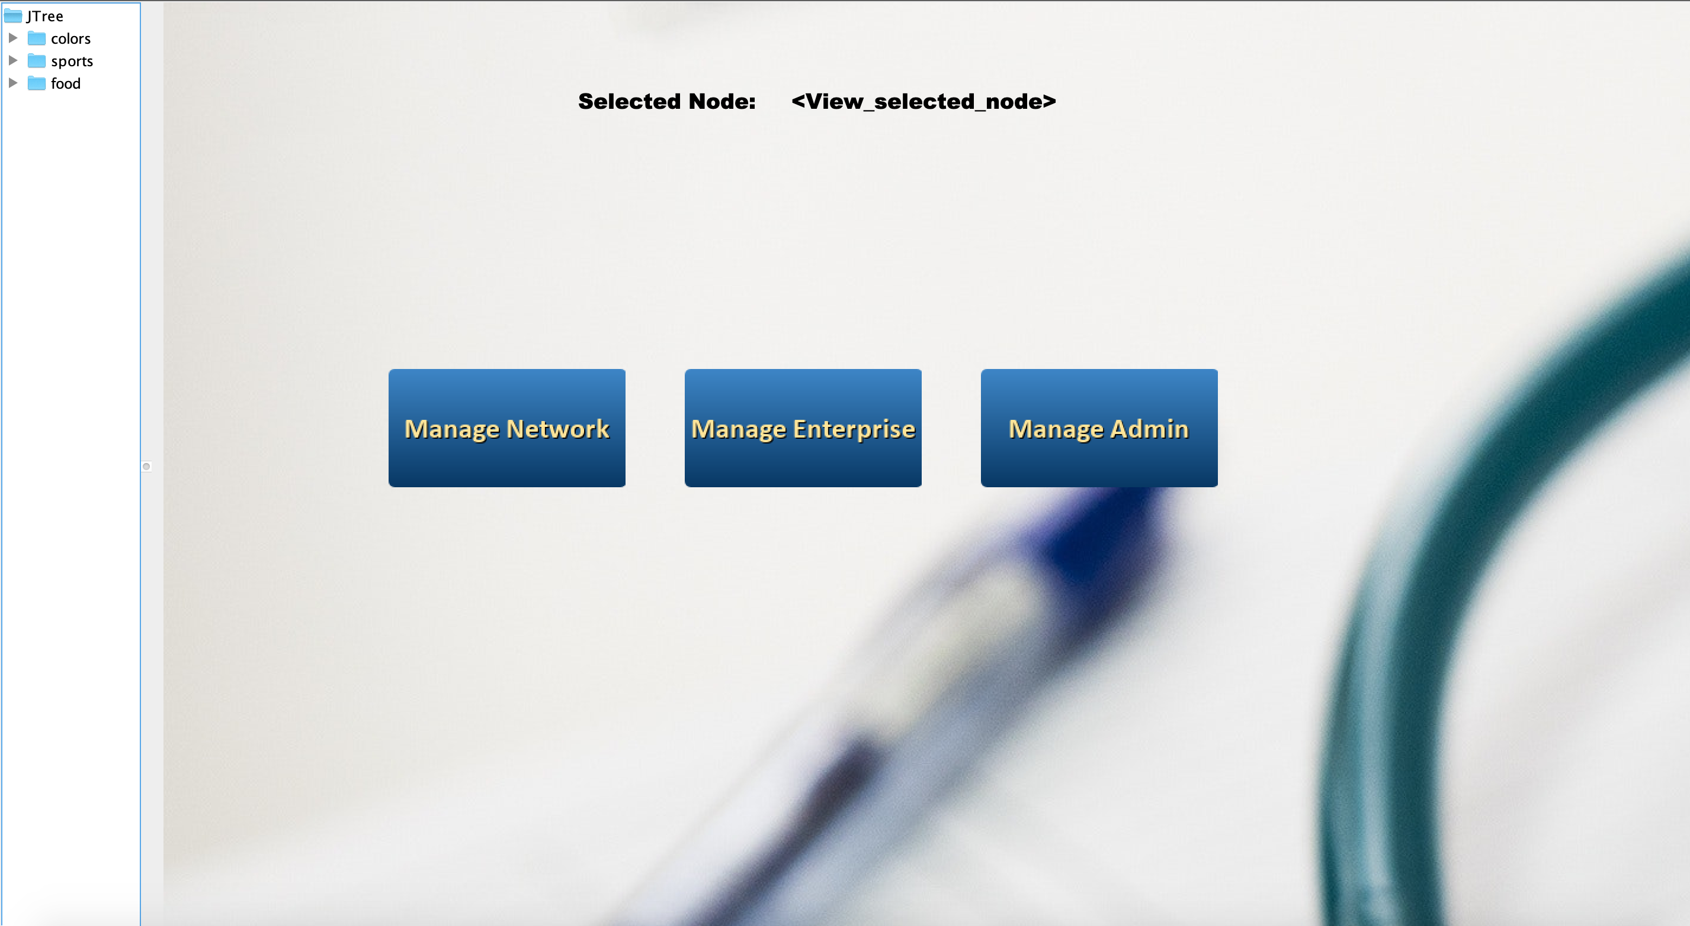
Admin Area

Slide 14
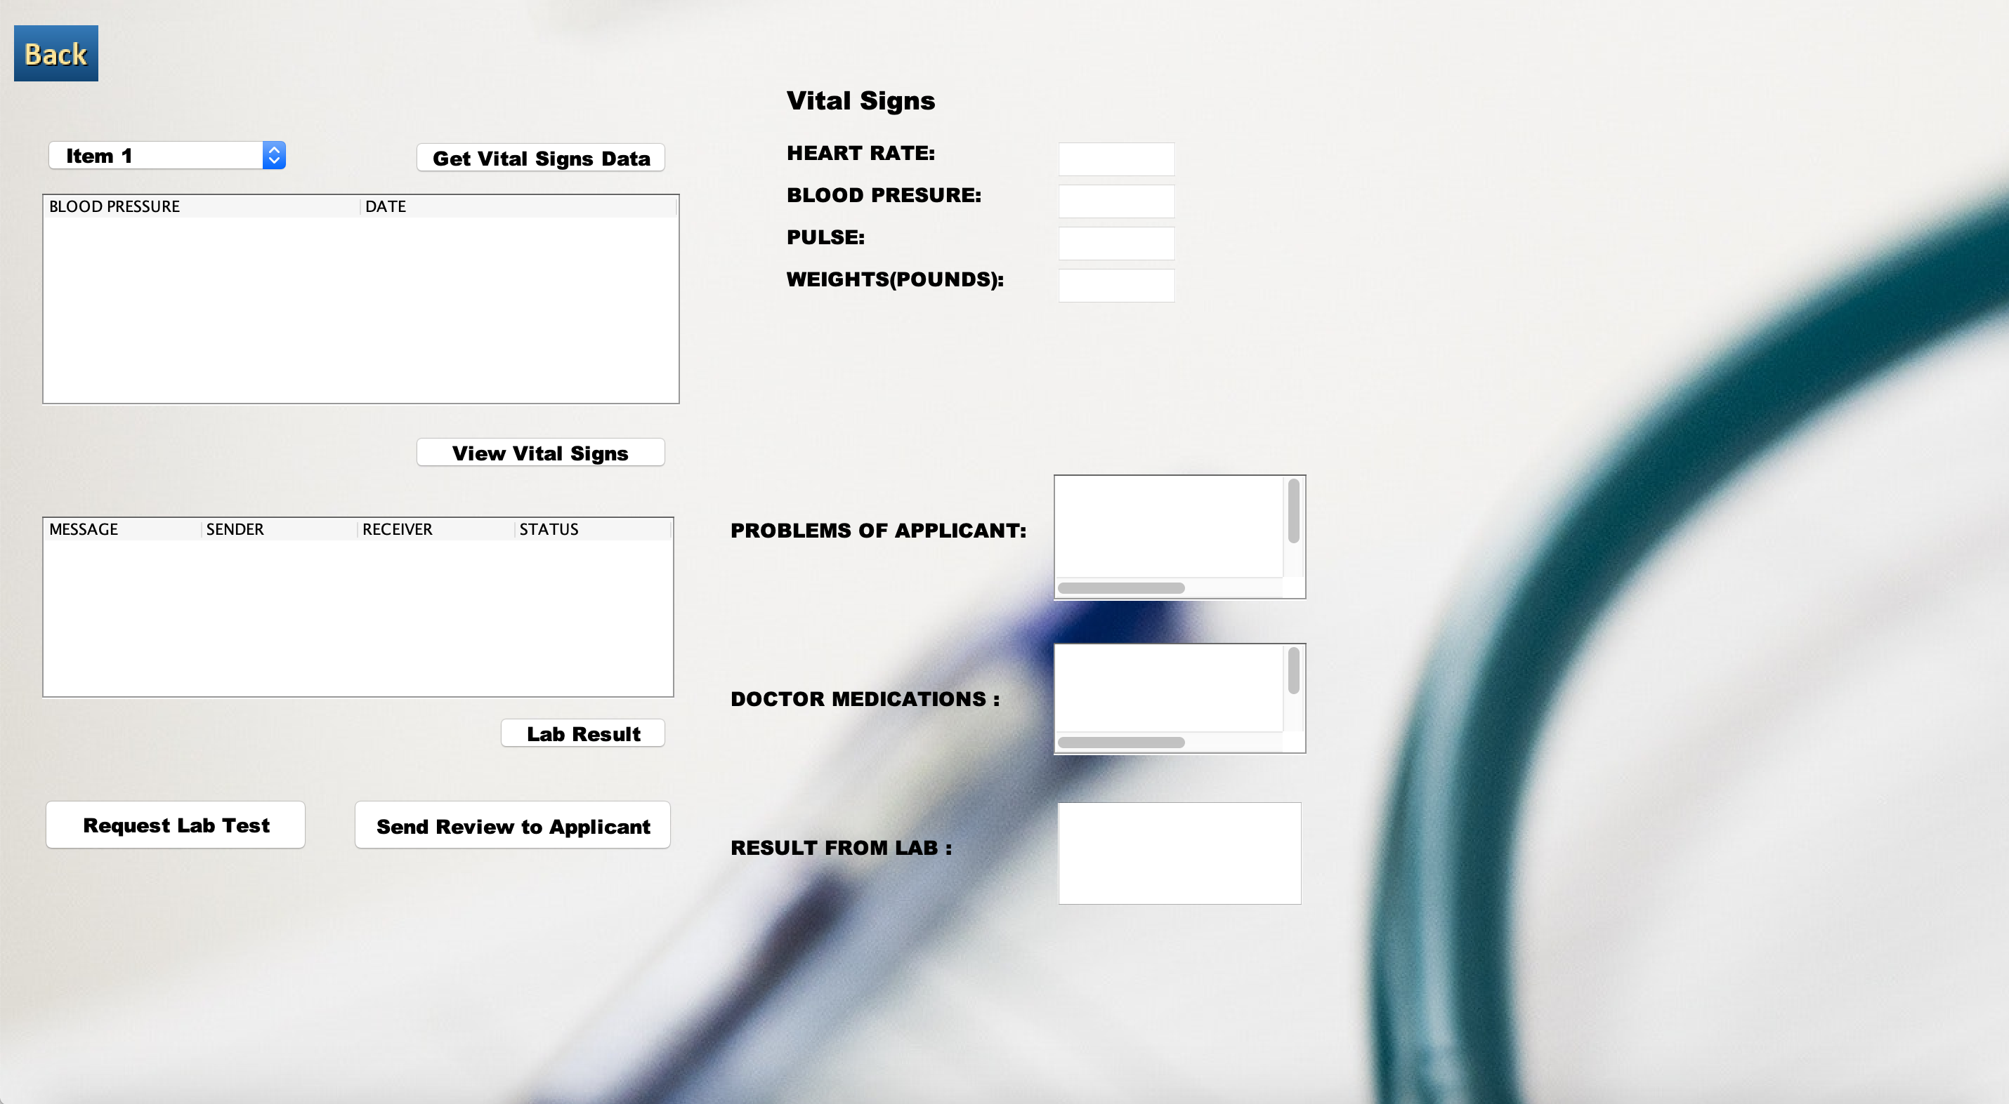
Doctor Work Area

Slide 15
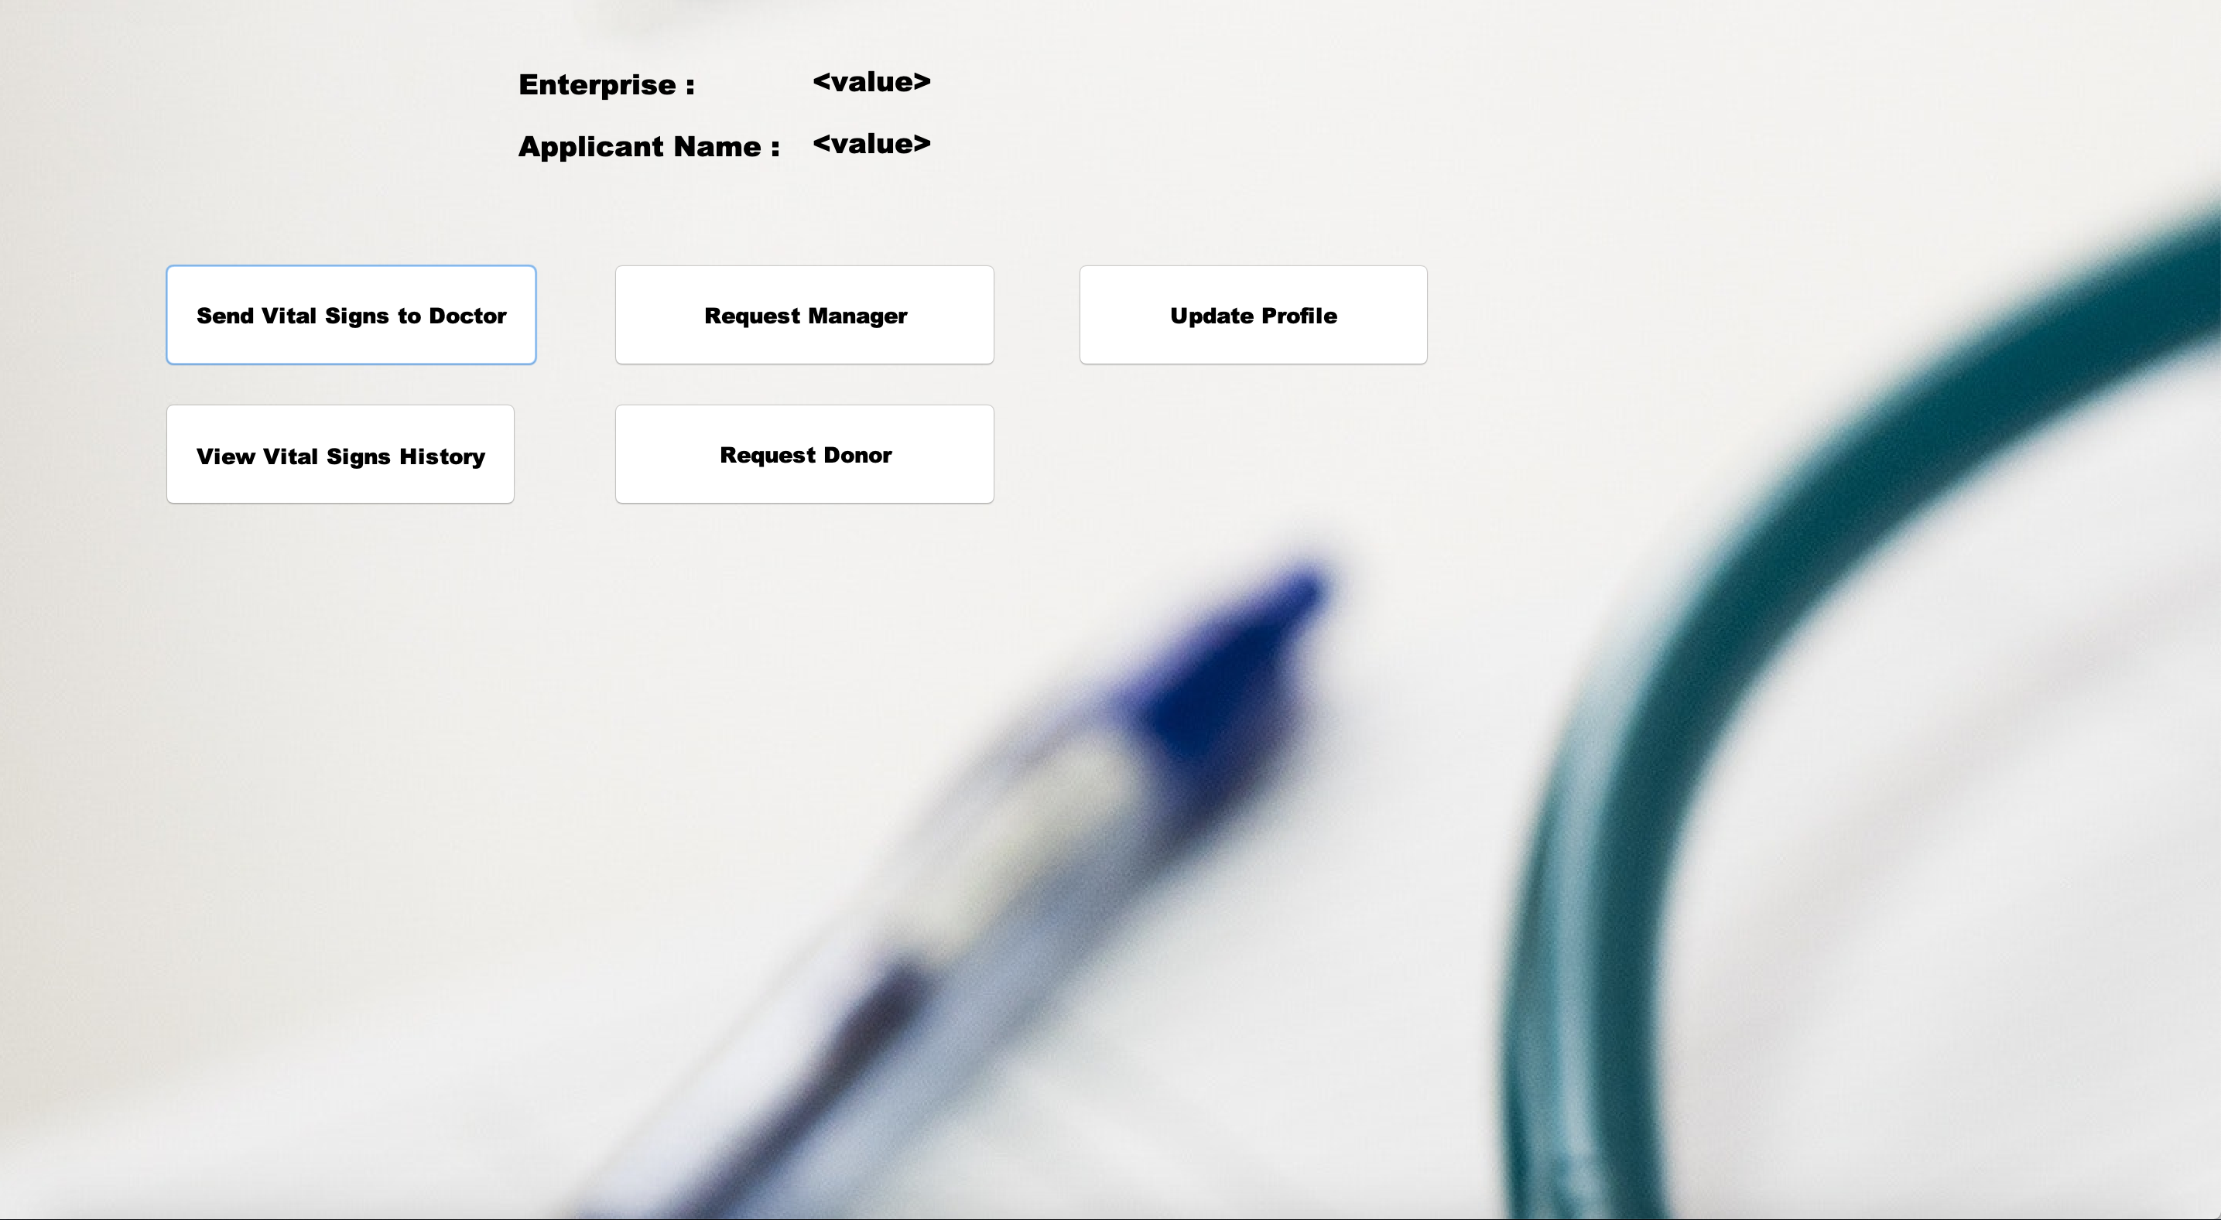
Applicant Portal

